Slide 1
Susan Askew. https://susanaskew.uk
Developing Methods in the Visual Arts for engagement, justice and hope.

Slide 2
RESEARCH QUESTION (progressive clarification of methods and field of violent discourse)
1.How can artistic interventions interrupt the iconography of oppression, objectification, invisibility (as subjects) and discourses of violence, in our societies, towards non-human animals?
2. How can installation interrupt the iconography of oppression, objectification, invisibility (as subjects) and discourses of violence, in our societies, towards non-human animals?
3. How can installation and fictioning interrupt the iconography of oppression, objectification, invisibility (as subjects) and discourses of violence, in our societies, towards non-human animals?
4. How can installation and fictioning interrupt the iconography of oppression, objectification, invisibility (as subjects) and discourses of violence toward non-human and human animals in biocapitalism?

Slide 3
AIMS
– How can I synthesise social critique with emotional experience?
– How can I synthesise a focus on subject and on process/materiality?
– How can drawing be used as a research method that contributes to new knowledge (rather than draws on knowledge already in the public sphere) (Simoniti, 2021)
– How can I bring my drawing into the public sphere and move toward a dialogic practice (Kester, ‘Conversation Pieces’ p. 23: dialogic art necessitates a shift in our understanding of what art is - away from the visual and sensory (which are individual experiences) and toward discursive exchange and negotiation).
- What can I contribute to knowledge about art-as-research?

Slide 4
THEORY
I am influenced by:
Foucauldian critical discourse analysis (Arribas-Ayllon and Walkerdine, 2008);
Post- humanism and post-anthropocentric theory (Haraway, 1988, Braidotti, 2021), which questions the assumption of human supremacy over the living world;
and importantly for my current work,
3. Critical Animal Studies (Best et al , 2007).

Slide 5
Methods:
Over the last year I have moved toward combining two methods:
1. Experiments in imagining otherwise/fictioning – I imagine a Museum of Human Violence, conceived ‘Post-Rupture’ that celebrates the opening of its ‘latest’ gallery in the year 2063. Crucially, by ‘fictioning’ the future as a time in which human violence has ended, I argue that this work is hopeful.
2. Installation – both ‘site specific’ and non-site specific. In an installation everything in the ‘space’ is part of the installation. The visitors therefore become part of The Museum of Human Violence, for example, they might consider their identify – are they human, AI, cyborg or perhaps interspecies? Installation is a useful method to shift the viewer’s experience toward discursive exchange (see aim ABOVE).
Other Animals have very often been objectified in visual art, but in addition their body parts are still used in the manufacture of many art materials. For me the first consideration in choice of medium is the question of whether the materials are vegan, (and, the second consideration, whether plastic free).

Slide 6
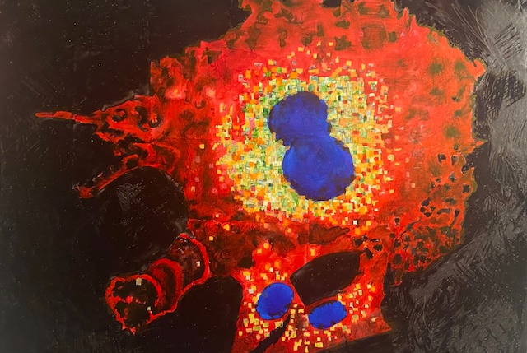
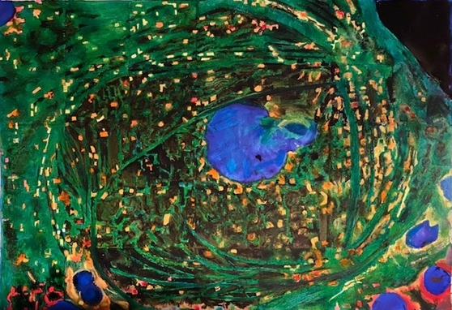
DEVELOPMENT OF AN IDEA: 1. CELL SIMILARITY: HUMAN AND NON HUMAN KIDNEY CELLS. BIRO ON PLIKE

Slide 7
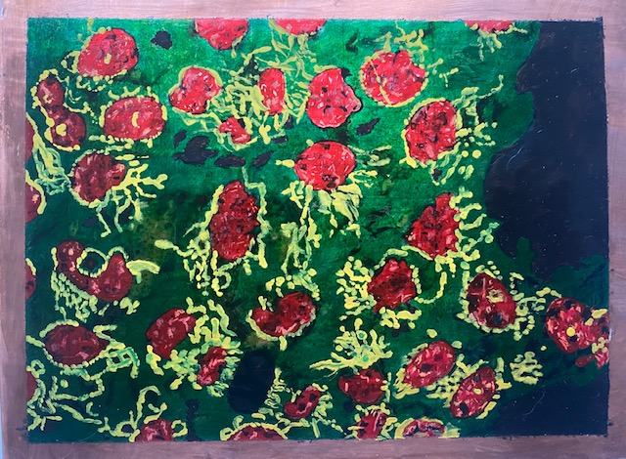
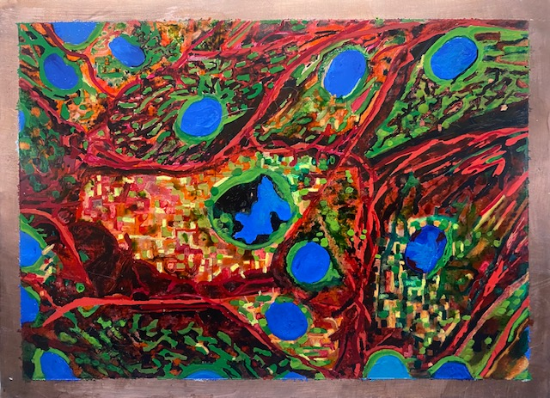
BIRO AND ENAMEL ON COPPER

Slide 8
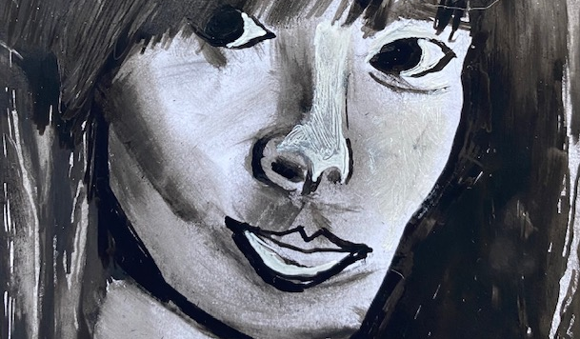
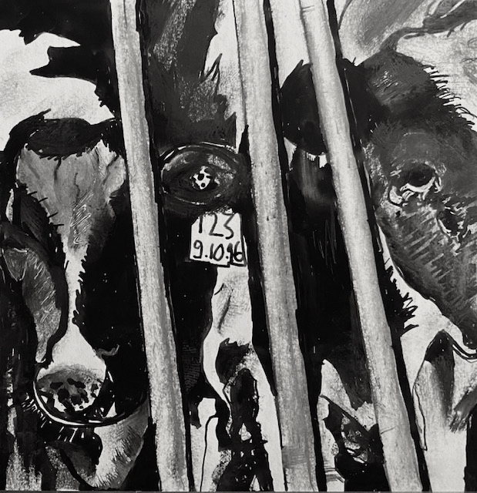
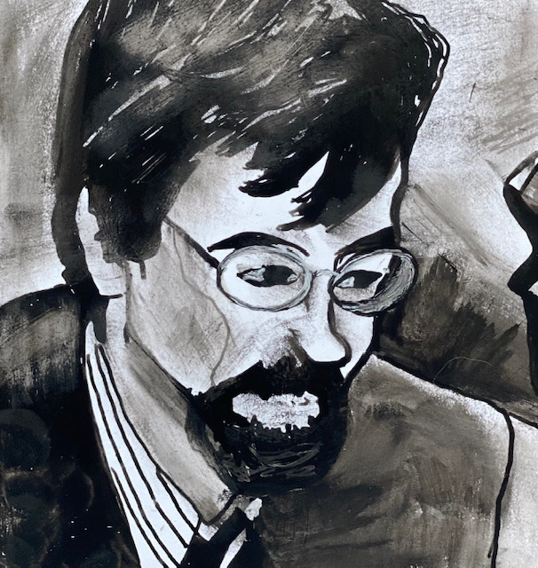
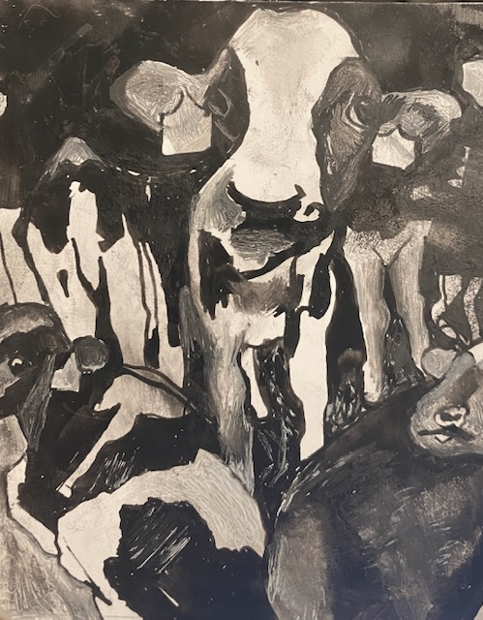
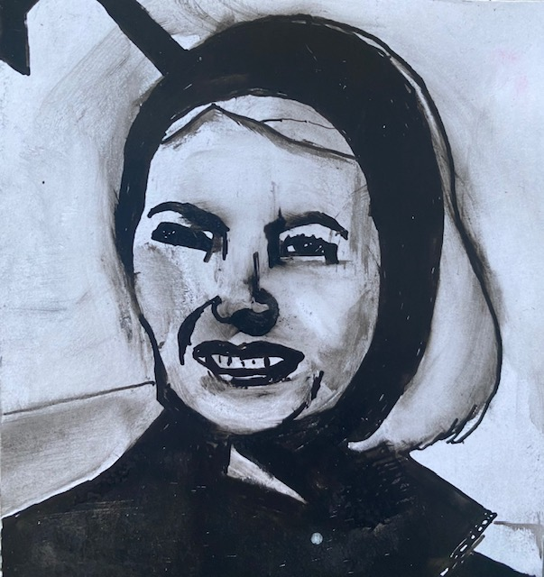
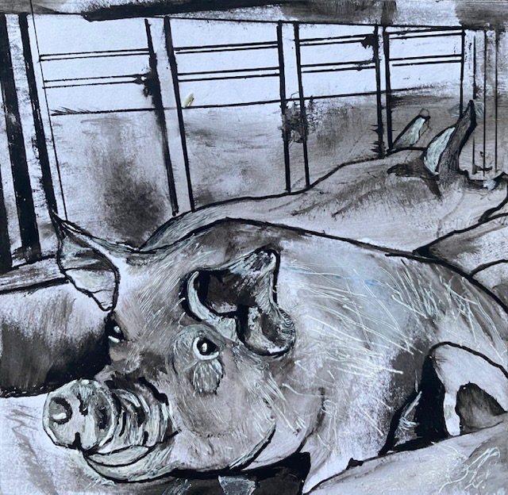
2. PORTRAITS OF THOSE KILLED BY THE ANIMAL AGRICULTURE INDUSTRY

Slide 9
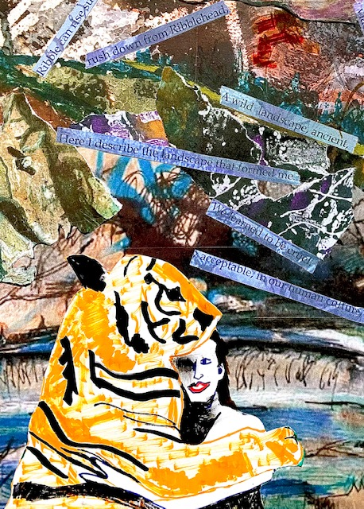
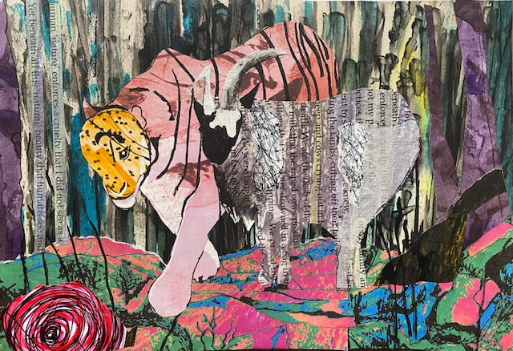
3. ‘IMAGINING OTHERWISE’ (OLUFEMI).COLLAGES. (REPURPOSING DRAWINGS AND PROSE POEM)

Slide 10
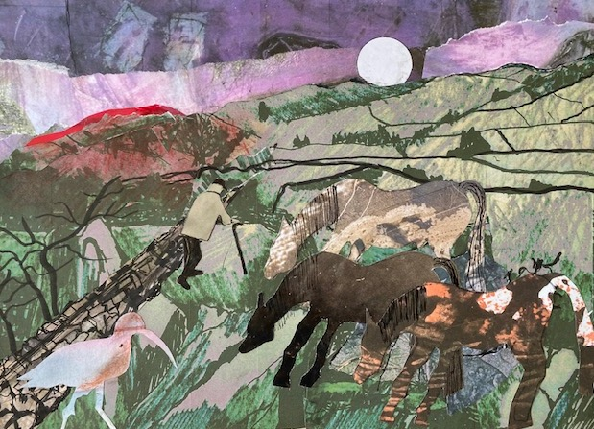
IMAGINING OTHERWISE

Slide 11
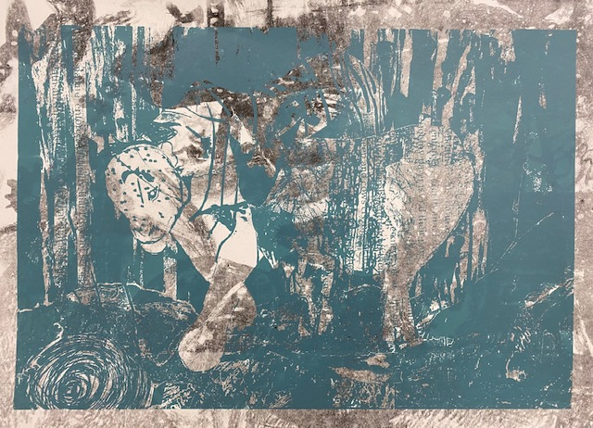
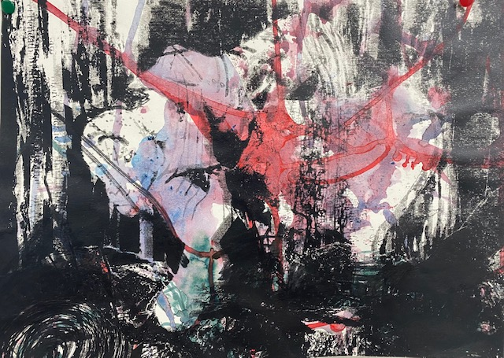
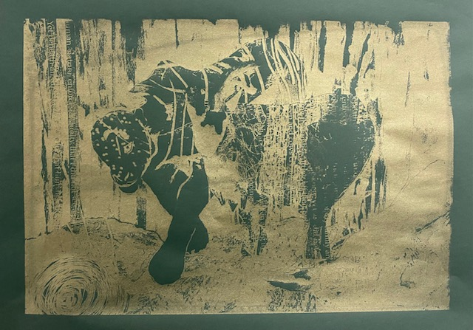
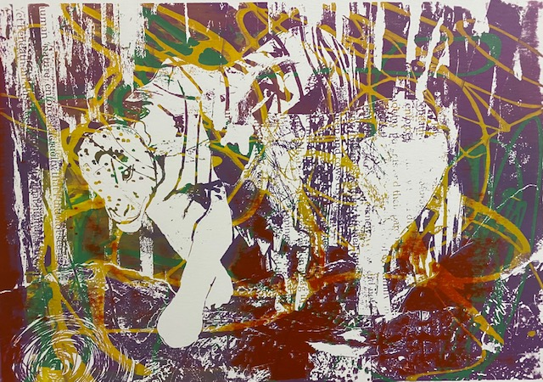
SCREEN PRINTED IMAGES

Slide 12
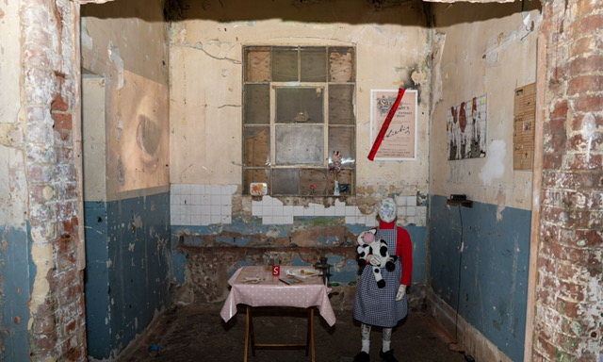

Slide 13
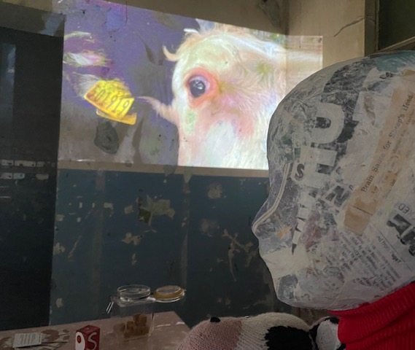
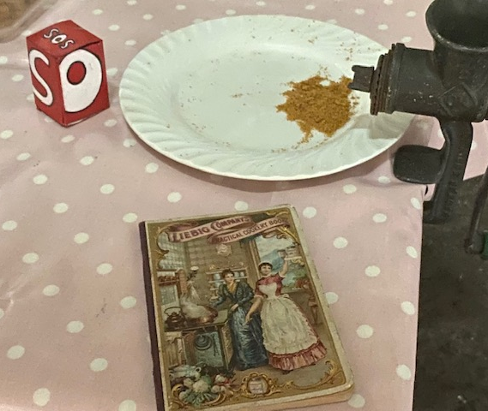
4. BARGEHOUSE: I LEARNED NOT TO LOOK

Slide 14
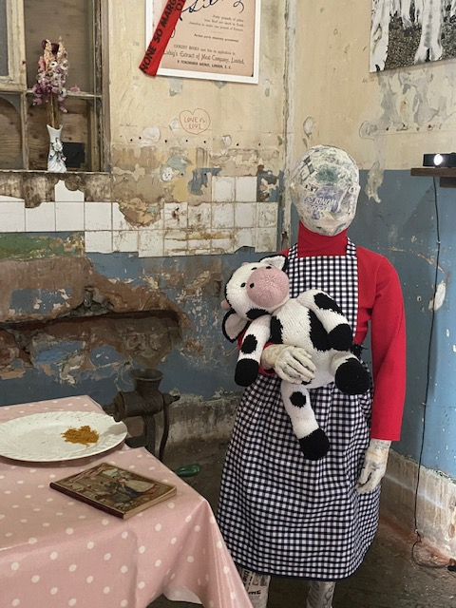

Slide 15
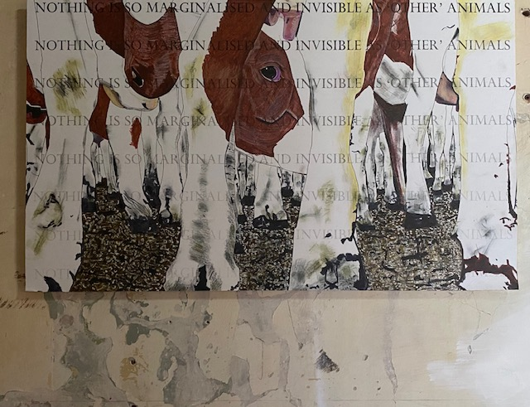
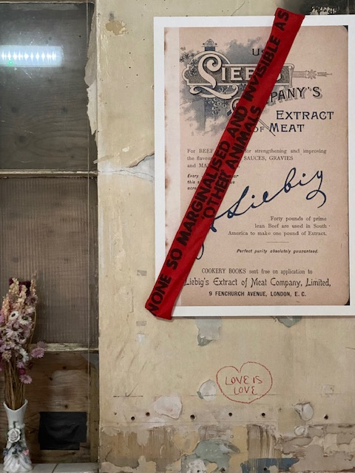

Slide 16
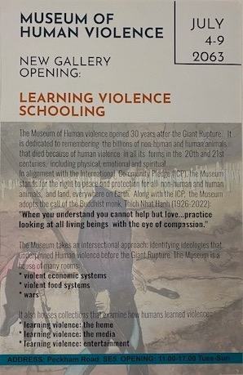
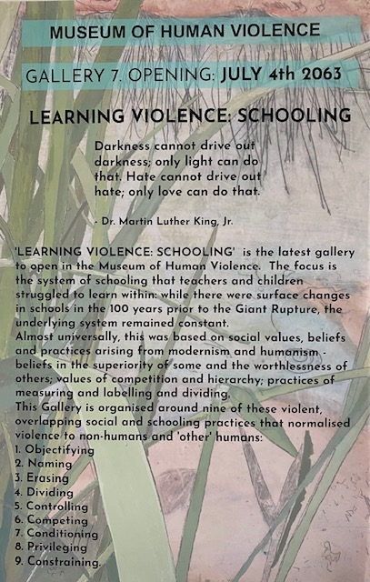
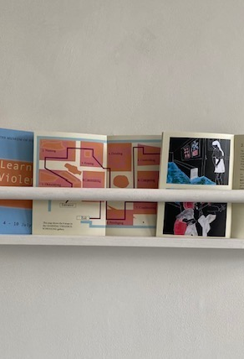
5. THE MUSEUM OF HUMAN VIOLENCE: LEARNING VIOLENCE: SCHOOLING

Slide 17
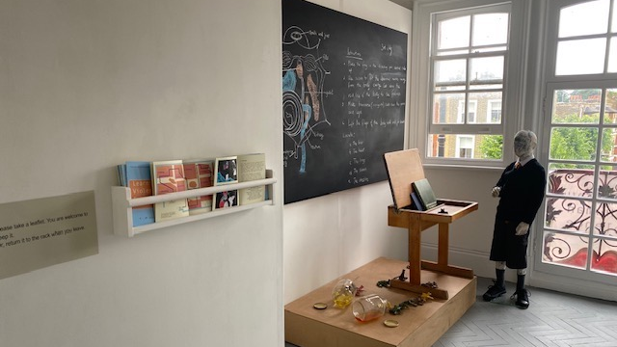

Slide 18
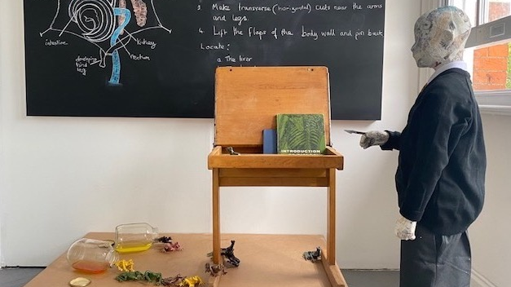

Slide 19
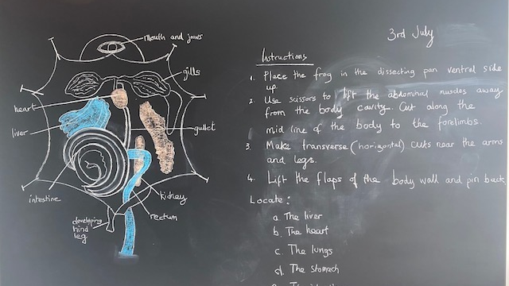

Slide 20
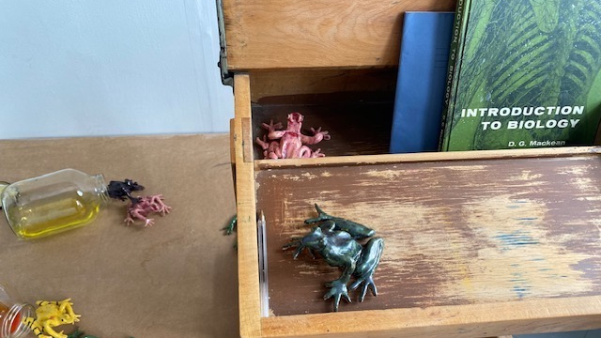

Slide 21
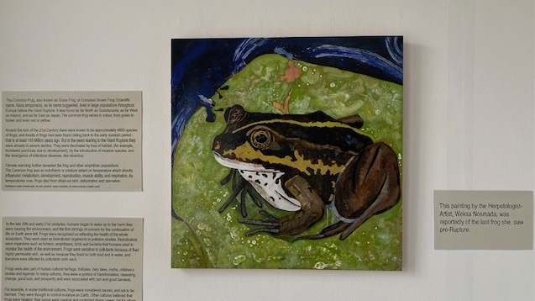

Slide 22
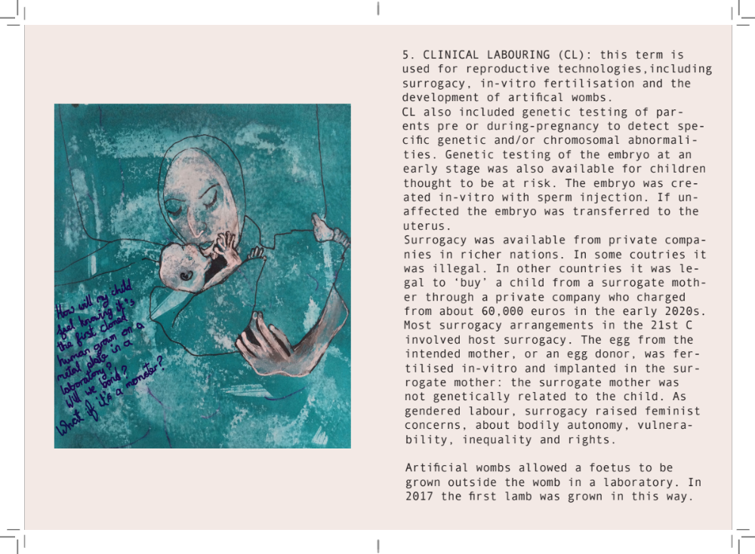
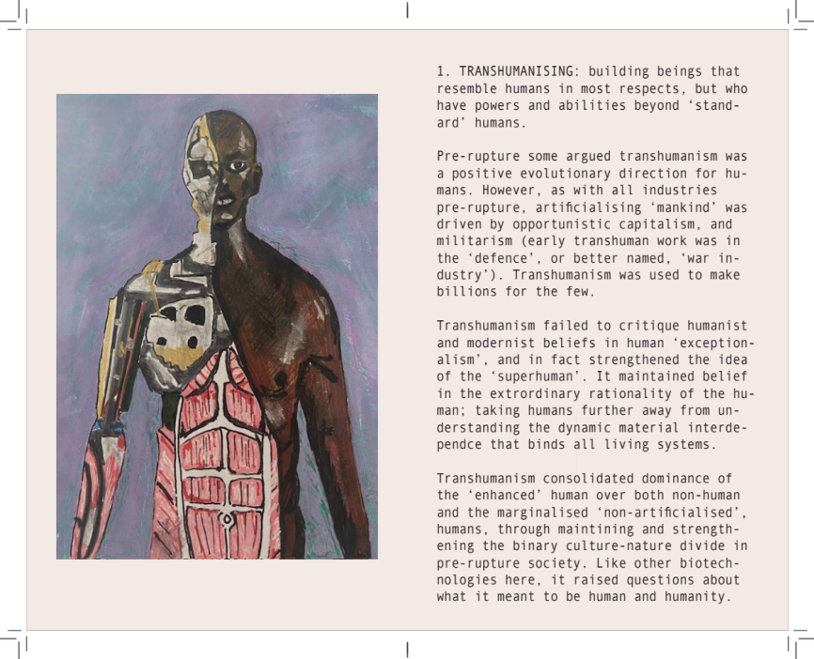
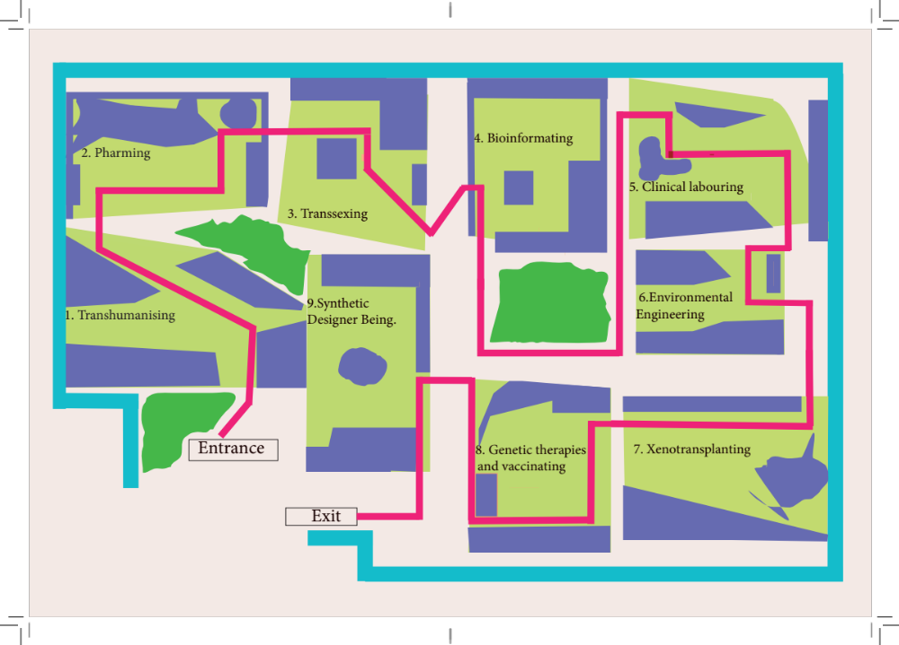
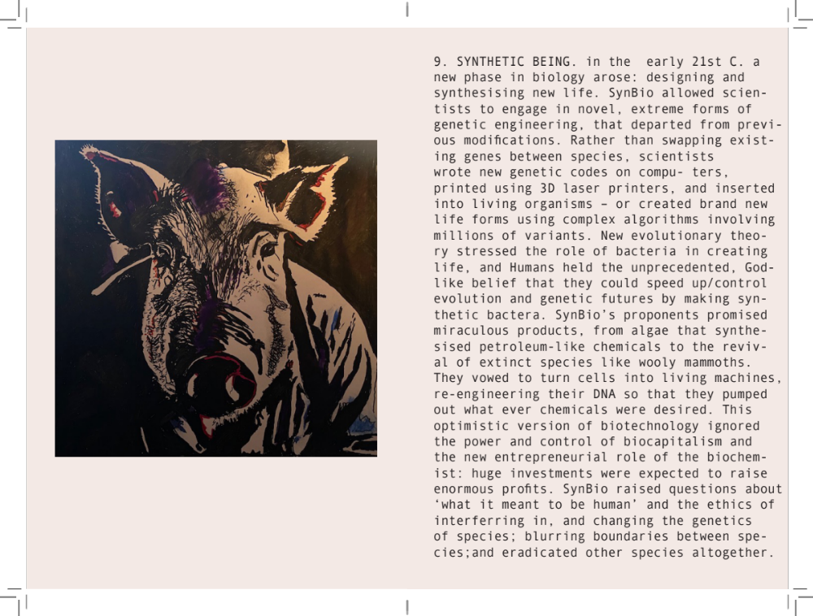
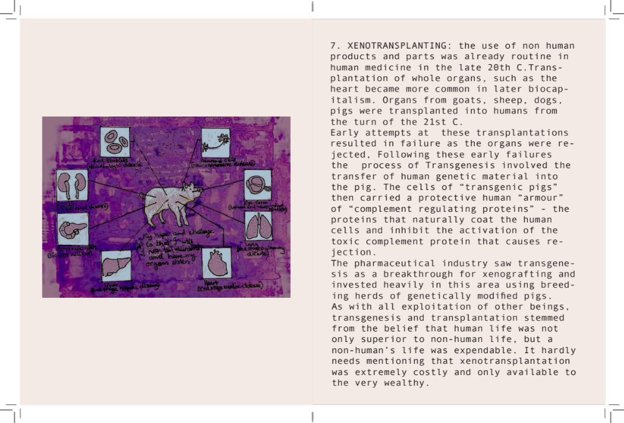
6.Discourses of violence to non-human and human animals in Biocapitalism

Slide 23
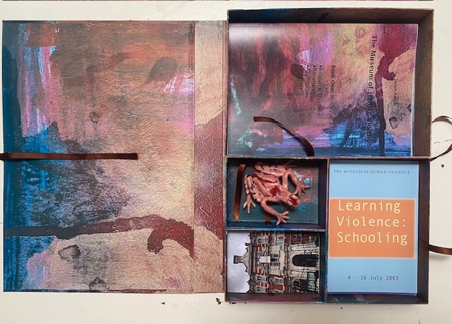
Research output for festival
Illustrated Essay on installation and fictioning for social justice
Book box containing booklets summarising research, postcards with images of works, ideas for next Gallery.
Performative lecture from the perspective of the curator in 2063

